Slide 1
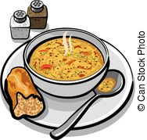
Allerton Church
Lent Lunch
Everyone
Welcome
Wednesday 22nd Feb 12.30 pm
“Stonehaven”, Stone Allerton, generously hosted by Elspeth and Chris Salmon.
Share a convivial and (somewhat!)
frugal meal of soup, bread, cheese and cider. Proceeds to ****
Tickets £5 at the door
For more details, contact
Johnny Torrens-Spence 01934 710188

